Slide 1
8086 Instruction Set

Slide 2
The 8086 microprocessor supports 8 types of instructions −
Data Transfer Instructions
Arithmetic Instructions
Bit Manipulation Instructions
String Instructions
Program Execution Transfer Instructions (Branch & Loop Instructions)
Processor Control Instructions
Iteration Control Instructions
Interrupt Instructions

Slide 3
Data Transfer Instructions
These instructions are used to transfer the data from the source operand to the destination operand. Following are the list of instructions under this group −
General purpose byte or word transfer instructions:
MOV : Copy byte or word from specified source to specified
destination
Syntax: MOV Destination, Source
Possible Combinations:
Source Destination
Reg Reg
Reg Mem
Mem Reg
Data Reg/Mem
Offset register Reg/Mem
Reg/Mem Segment register except CS
-The branching instructions can use the registers CS and IP to store data.Other instructions are not permitted to write data in CS and IP.

Slide 4
XCHG : Exchange the contents of the specified source and destination operands one of which may be a register or memory location.
Possible Combinations:
Source Destination
Reg Reg
Reg Mem
Ex: XCHG AL, BL
PUSH Operand:
  It pushes the operand into top of stack.
  E.g.: PUSH BX
POP Des:
  It pops the operand from top of stack to Des.
  Des can be a general purpose register, segment register (except CS) or memory location.
  E.g.: POP AX

Slide 5
Simple input and output port transfer instructions
IN Accumulator, Port Address:
  It transfers the operand from specified port to accumulator register.
  E.g.: IN AX, 0028 H
OUT Port Address, Accumulator:
  It transfers the operand from accumulator to specified port.
  E.g.: OUT 0028 H, AX

Slide 6
Special address transfer instructions
LEA Register, Src:
  It loads a 16-bit register with the offset address of the data specified by the Src.
  E.g.: LEA BX, [DI]
    This instruction loads the contents of DI (offset) into the BX register.
LDS Des, Src:
  It loads 32-bit pointer from memory source to destination register and DS.
  The word is placed in the destination register and the segment is placed in DS.
  This instruction Copies the word at the lower memory address to the Des reg and the word at the higher address to the segment reg i.e. DS.
  E.g.: LDS BX, [0301 H]
LES Des, Src:
  It loads 32-bit pointer from memory source to destination register and ES.
  The Word is placed in the destination register and the segment is placed in ES.
  This instruction is very similar to LDS except that it initializes ES instead of DS.
  E.g.: LES BX, [0301 H]

Slide 7
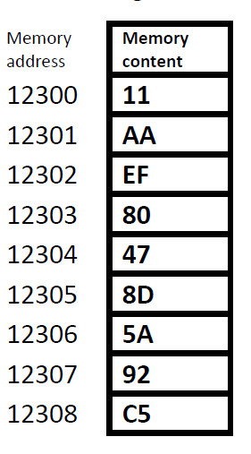
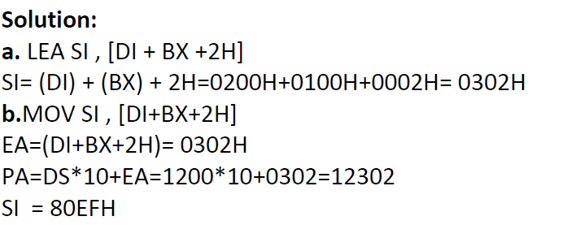
Ex: Assuming that (BX)=100H, DI=200H, DS=1200H, SI= F002H, AX= 0105H, and the following memory content. what is the result of executing the following instructions?
a. LEA SI , [ DI + BX +2H]
b. MOV SI , [DI+BX+2H]

Slide 8
Flag transfer registers
LAHF : Load AH with the low byte of the flag register
SAHF : Store AH register to low byte of flag register
PUSHF : Copy flag register to top of the stack
POPF : Copy word at top of the stack to flag register

Slide 9
Arithmetic Instruction
These instructions are used to perform various mathematical operations like addition, subtraction, multiplication and division etc….
Addition instructions
ADD : Add specified byte to byte or word to word
Syntax: ADD Destination, Source
Ex: ADD AX,BX
ADC : Add with carry
Syntax: ADC Destination, Source
INC : Increment specified byte or specified word by 1
Eg: INC AX

Slide 10
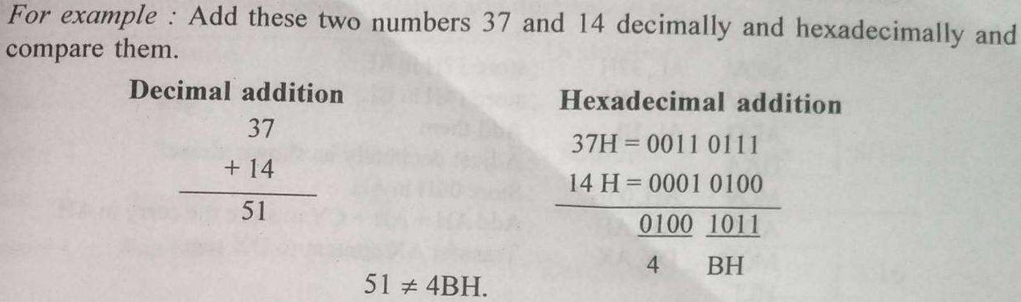
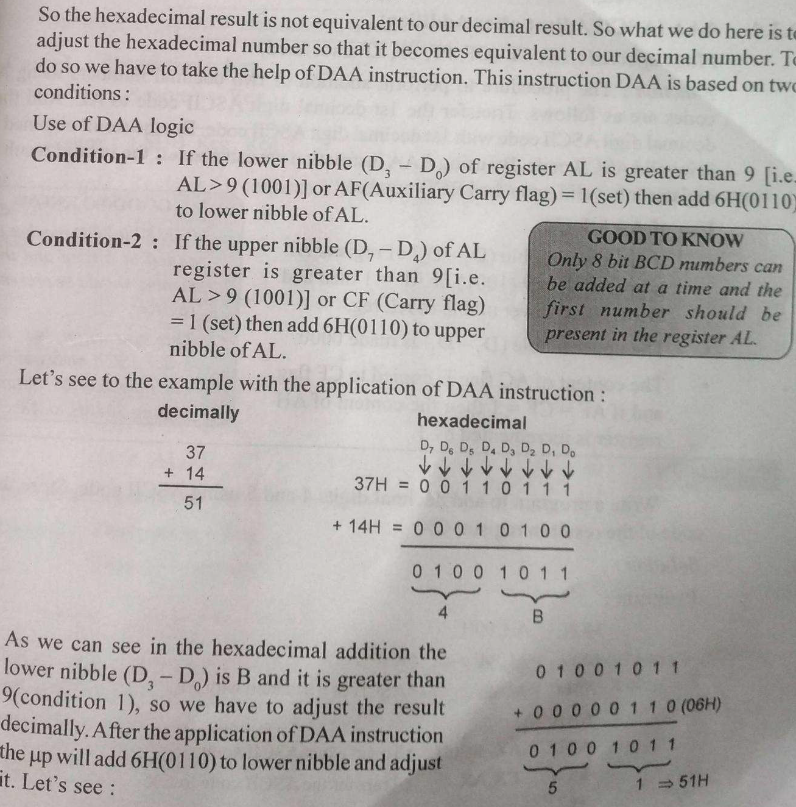
DAA : Decimal adjust after addition
-This instruction is used to convert invalid BCD numbers into valid BCD numbers.

Slide 11
Subtraction instructions
SUB : Subtract byte from byte or word from word
Syntax: SUB Destination, Source
SUB AL, 0FH ; subtract the immediate content, 0FH from the content of AL and store the result in AL
Ex: SUB AX, BX ; AX <= AX-BX
SBB: SUBTRACT WITH BORROW
subtracts the source operand and the borrow flag (CF) which may reflect the result of the previous calculations, from the destination operand.
Subtraction with borrow, here means subtracting 1 from the subtraction obtained by SUB, if carry (borrow) flag is set.

Slide 12
Multiplication instructions
MUL : Multiply unsigned byte by byte or unsigned word or word.
This instruction will multiple unsigned operand 8-bit/16-bit with AL/AX and store the result in AX/DX-AX.
If operand is of 8-bit then multiply it with contents of AL and the result will be of 16-bit.
-The MSB will be stored in AH and LSB will be stored in AL.
If operand is of 16-bit then multiply it with contents of AX and the result will be of 32 bit.
-The lower 16-bit will be stored in AX and upper 16 bit will be stored in DX.
E.g: MUL BH
A
AX
BX
XX X
XX 04
X
02 XX
00 08
AH AL
AH AL
BH BL

Slide 13
IMUL : Multiply signed bye by byte or signed word by word
AAM : ASCII adjust after multiplication
Division instructions
DIV : This instruction will divide unsigned operand AX/DX-AX by 8-bit/16-bit number and store the result in AX/DX-AX
E.g: DIV BL
If AL=AX/Operand (8-bit)
Then AL= Quotient, AH=Remainder.
If AX=DX-AX(32 bit)/Operand (16-bit)
Then AX= Quotient, DX=Remainder.
AX
AX
BX
88 88
88 88
04 04
12
/
XX 22
AH AL
AH AL
BH BL

Slide 14
IDIV : Divide signed word by byte or signed double word by word
when operand is a byte:
AL = AX / operand
AH = remainder (modulus)
when operand is a word:
AX = (DX AX) / operand
DX = remainder (modulus)
AAD : ASCII adjust after division
CBW : Fill upper byte of word with copies of sign bit of lower byte
CWD : Fill upper word of double word with sign bit of lower word.

Slide 15
Bit Manipulation Instructions
These instructions are used to perform operations where data bits are involved, i.e. operations like logical, shift, etc.
Instructions to perform logical operation
NOT − Used to invert each bit of a byte or word.
AND − Used for adding each bit in a byte/word with the corresponding bit in another byte/word.
OR − Used to multiply each bit in a byte/word with the corresponding bit in another byte/word.
XOR − Used to perform Exclusive-OR operation over each bit in a byte/word with the corresponding bit in another byte/word.
TEST − Used to add operands to update flags, without affecting operands.

Slide 16
Instructions to perform shift operations
SHL/SAL − Used to shift bits of a byte/word towards left and put zero(S) in LSBs.
SHR − Used to shift bits of a byte/word towards the right and put zero(S) in MSBs.
SAR − Used to shift bits of a byte/word towards the right and copy the old MSB into the new MSB.

Slide 17
Instructions to perform rotate operations
ROL − Used to rotate bits of byte/word towards the left, i.e. MSB to LSB and to Carry Flag [CF].
ROR − Used to rotate bits of byte/word towards the right, i.e. LSB to MSB and to Carry Flag [CF].
RCR − Used to rotate bits of byte/word towards the right, i.e. LSB to CF and CF to MSB.
RCL − Used to rotate bits of byte/word towards the left, i.e. MSB to CF and CF to LSB.

Slide 18
String Instructions
String is a group of bytes/words and their memory is always allocated in a sequential order.
Following is the list of instructions under this group −
REP − Used to repeat the given instruction till CX ≠ 0.
REPE/REPZ − Used to repeat the given instruction until CX = 0 or zero flag ZF = 1.
REPNE/REPNZ − Used to repeat the given instruction until CX = 0 or zero flag ZF = 1.
MOVS/MOVSB/MOVSW − Used to move the byte/word from one string to another.
COMS/COMPSB/COMPSW − Used to compare two string bytes/words.
INS/INSB/INSW − Used as an input string/byte/word from the I/O port to the provided memory location.
OUTS/OUTSB/OUTSW − Used as an output string/byte/word from the provided memory location to the I/O port.
SCAS/SCASB/SCASW − Used to scan a string and compare its byte with a byte in AL or string word with a word in AX.
LODS/LODSB/LODSW − Used to store the string byte into AL or string word into AX.

Slide 19
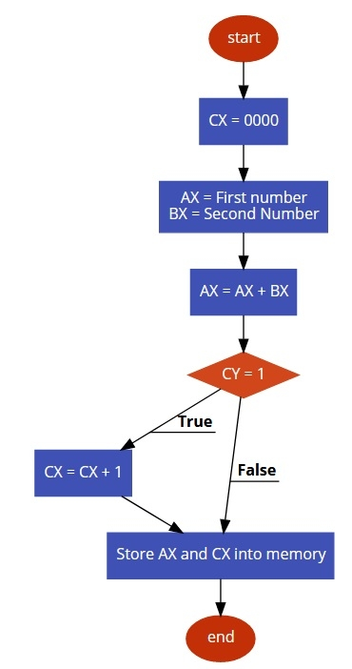
Ex: Write 8086 Assembly language program to add two 16-bit number stored in memory location 3000H – 3001H and 3002H – 3003H.

Slide 20
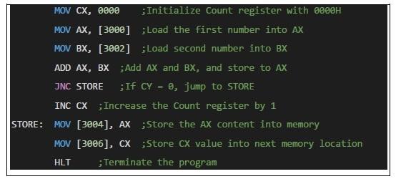

Slide 21
Ex:
Three consecutive memory locations i.e. 3000H,3001H,3002Hwill contain three data like 10H,20H,30H respectively. Write a program to add all these numbers and store the result in 4002H location. Neglect if any carry is generated.
Program:
MOV AX,3000H
MOV DS, AX
MOV SI, 0000H
MOV BL,00H
ADD BL,[SI]
MOV SI,0001H
ADD BL, [SI]
MOV SI, 0002H
ADD BL, [SI]

Slide 22
Problem – Write a program to add the content of memory location 2000 : 0500 with content of memory location 3000 : 0600 and store result into 5000 : 0700 memory location.

